Slide 1



Introduction
Chardon Police Department Executive Lieutenant
Valley Enforcement Group Swat Team
  Commander (14yrs experience)
F.B.I National Academy class 231
Sergeant United States Army 1991-1997
  1995 Soldier of the Year for entire U.S Army
  Deployed in multiple hazardous duty areas

Slide 2
What is workplace violence?
Any act or threat of physical violence, harassment, intimidation, disruptive behavior occurring at the work site
Can involve employees, clients, customers, visitors, or family
Recognized as a specific category of violent crime calling for distinct response

Slide 3

Examples
threats
harassment
verbal abuse
assault
murder
active shooter

Slide 4

Prevention
Appropriate precautions
  Zero-tolerance policy covering everyone
  Implement workplace violence prevention program
  Physical security measures
    Controlled access
    Ask or act when you see a new person

Slide 5

It will never happen here…

Slide 6
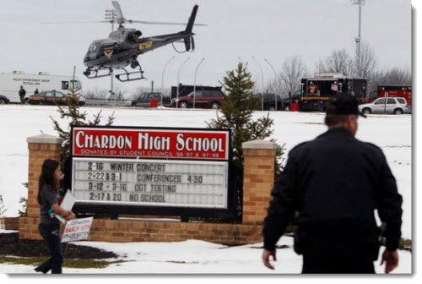
Prepare for the following
Active shooting
Law enforcement response
EMS response
Crime scene secured
Investigation
  Interview witnesses
  Accountability
Clean up

Slide 7
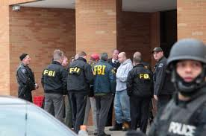
Active Shooter
Be alert
Lockdown
Evacuate
Prepare to fight (barricade, move, scream, throw things, takedown)
  Survivor attitude- Surprised should not mean defeated

Slide 8
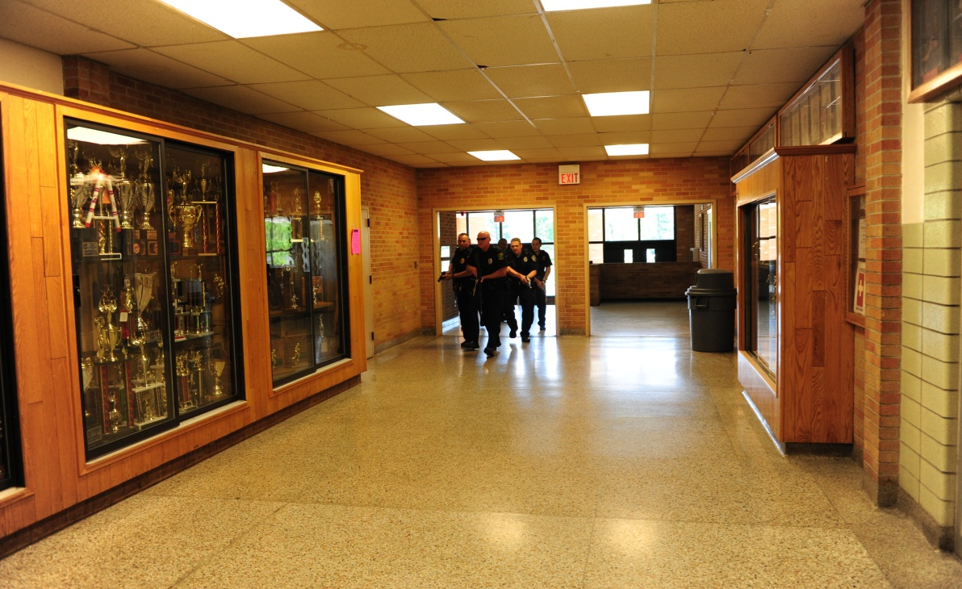
How to be prepared
Planning and Preparation are key to Survival
Prepare like it will happen
Plan should include options on:
  How to respond
  How to report
  Evacuation points
  Victim notifications

Slide 9
Practice, Train, Test Plan
  Teach skills that interrupt the act of shooting accurately
  Teach skills that will allow the targets to benefit from unknown advantages
    Distance, time, movement, numbers
  No perfect plan

Slide 10
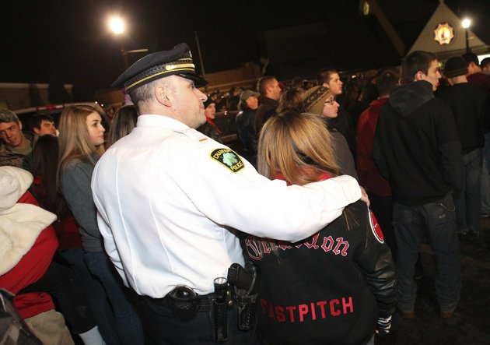
We cannot stop all events, but we need to have a general knowledge of how to deal with it

Slide 11

Questions?
Lt. Troy Duncan
  tduncan@chardon.cc
  440-286-6123

